Slide 1
Recommendation Engine
Group 4

Slide 2
Q1
What is the purpose of the recommendation engine ?

Slide 3
Offer customized recommendation tailored to customers’ taste
Use past behavior of existing customers to recommend products
Capture more customers/ Retention
Increase sale value and volume

Slide 4
Q6
How to use matrix factorization in recommendation engine ?

Slide 5
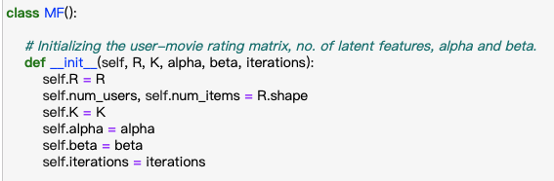
Notes:
R – The user-movie rating matrix
K – Number of latent features
alpha – Learning rate for stochastic gradient descent
beta – Regularization parameter for bias
#iterations – Number of iterations to perform stochastic gradient descent

Slide 6
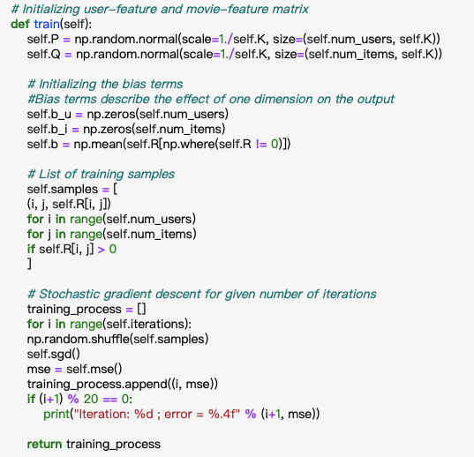

Slide 7
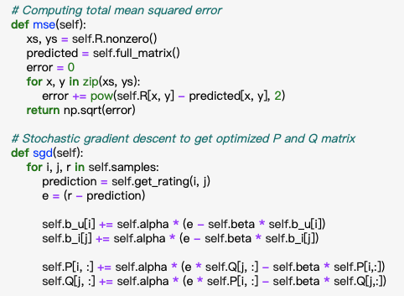

Slide 8
